Slide 1




Mode
Switching
PressrueControl
Soft
Actuator
SMC
NDOB

Slide 2
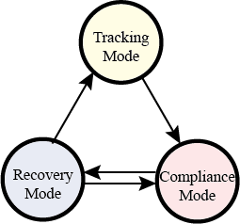
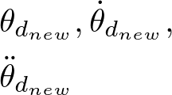
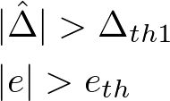


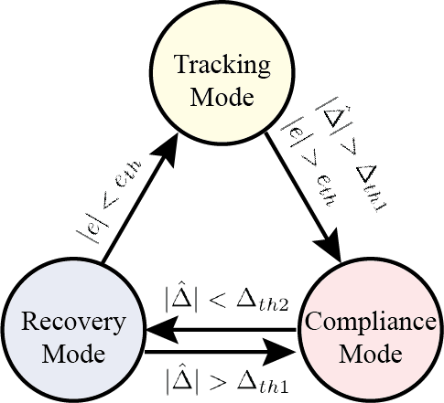

Mode Switching
Pressure Control
Soft
Actuator
SMC
NDOB

Slide 3



Torque/Force Controller
Pressure Controller
2-Segment
Soft Arm
INASMC
$$\hat{d}$$
Inner Loop
INDOB

